Slide 1
Reinforcement Learning
Garrett McNeill

Slide 2
What is Reinforcement Learning
In traditional machine learning, we learn from datasets.
In reinforcement learning, we learn from experiences.
Used in wide variety of fields
  Medicine
  Robotics
  LLMs

Slide 3
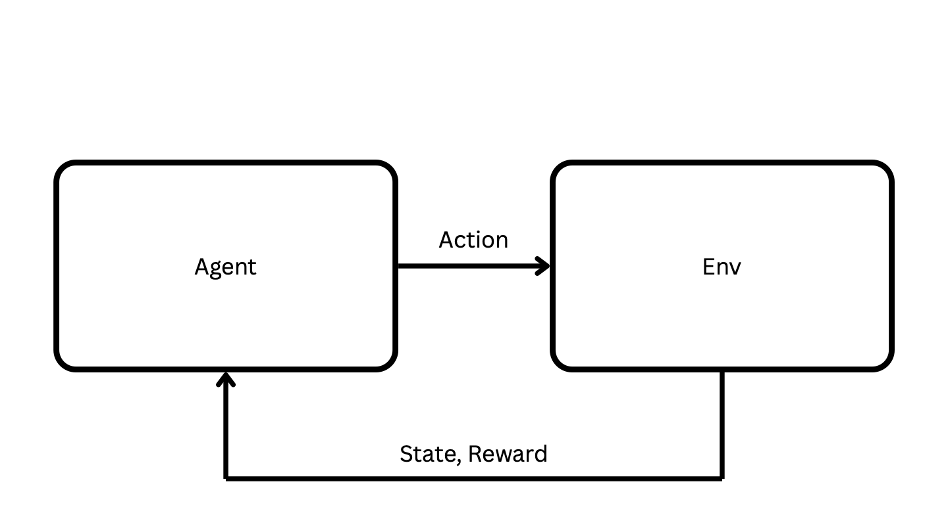
What is Reinforcement Learning?
Instead of training on data, we train on actions and observations
Trying to learn a policy, not plan a route
Non-deterministic environments

Slide 4
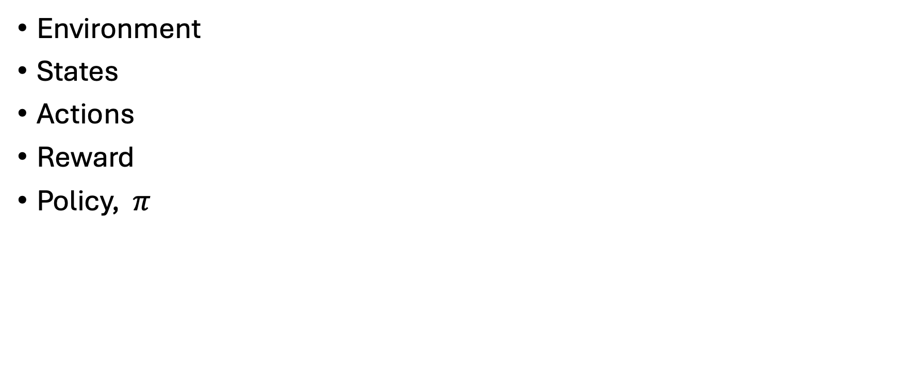
Components of Reinforcement Learning
Environment
States
Actions
Reward
Policy, $π$

Slide 5
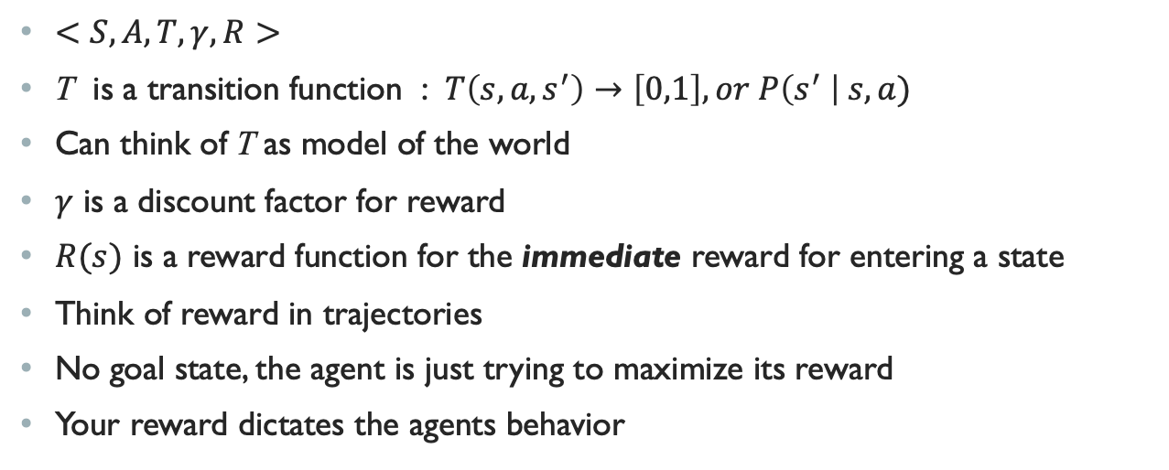
Markov Decision Process (MDP)
$<S, A, T, γ, R>$
T is a transition function : $T\left(s, a, s^{′}\right)→\left[0,1\right], or P\left(s^{′} \right| s, a)$
Can think of T as model of the world
$γ$ is a discount factor for reward
$R(s)$ is a reward function for the immediate reward for entering a state
Think of reward in trajectories
No goal state, the agent is just trying to maximize its reward
Your reward dictates the agents behavior
Notes:
Markov assumption is that your next state only depends on your current state. This works, since we can assure now that all information about our past states is contained in our current state. Here is a nice spot to go over the different types of environements

Slide 6
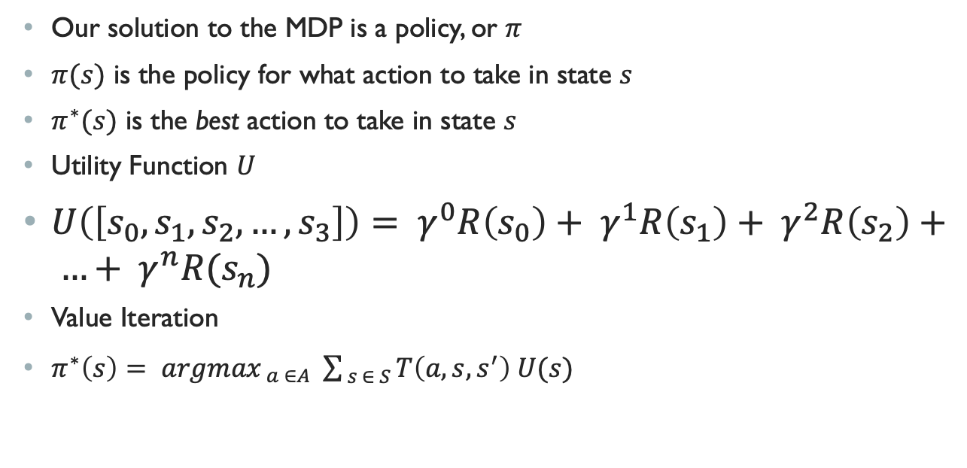
Policy
Our solution to the MDP is a policy, or $π$
$π(s)$ is the policy for what action to take in state $s$
$π^{∗}(s)$ is the best action to take in state $s$
Utility Function $U$
$U\left(\left[s_{0}, s_{1}, s_{2}, …, s_{3}\right]\right)= γ^{0}R\left(s_{0}\right)+ γ^{1}R\left(s_{1}\right)+ γ^{2}R\left(s_{2}\right)+ …+ γ^{n}R(s_{n})$
Value Iteration
$π^{∗}\left(s\right)= {argmax}_{ a ∈A} \sum_{ s ∈ S}{T\left(a, s, s^{′}\right) U(s)}$

Slide 7
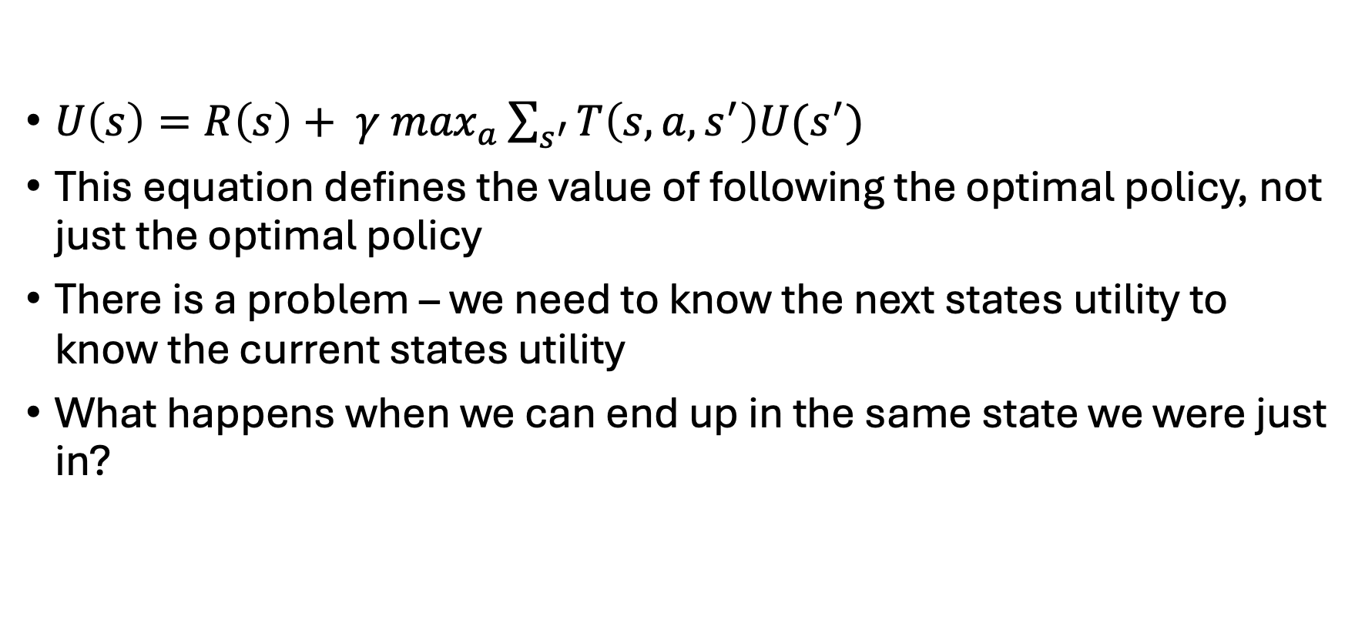
Bellman Equation
$U\left(s\right)=R\left(s\right)+ γ \max_{a}\sum_{s^{′}}{T\left(s, a, s^{′}\right)U(s^{′})}$
This equation defines the value of following the optimal policy, not just the optimal policy
There is a problem – we need to know the next states utility to know the current states utility
What happens when we can end up in the same state we were just in?

Slide 8
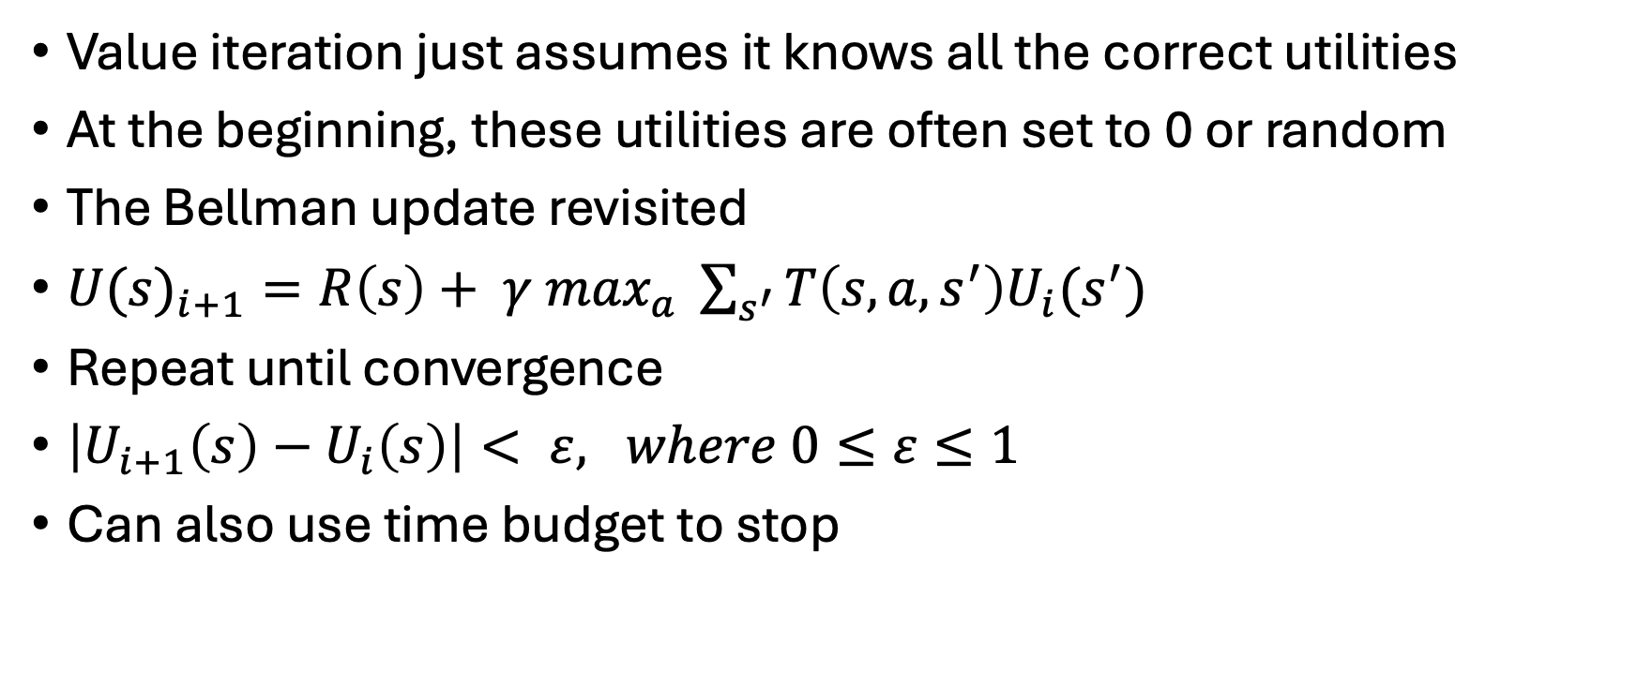
Value Iteration
Value iteration just assumes it knows all the correct utilities
At the beginning, these utilities are often set to 0 or random
The Bellman update revisited
${U(s)}_{i+1}=R\left(s\right)+ γ\max_{a} \sum_{s^{′}}{T\left(s, a, s^{′}\right)U_{i}(s^{′})}$
Repeat until convergence
$\left|U_{i+1}\left(s\right)−U_{i}\left(s\right)\right|< ε, where 0≤ε≤1$
Can also use time budget to stop
Notes:
Good metaphor for segway into policy iteration. How does having a action that is clearly better than others affect how long value iteration runs for? It doesn’t!! Value iteration is still going to run until it finds the actual value of the action / state pair, even if its terrible

Slide 9
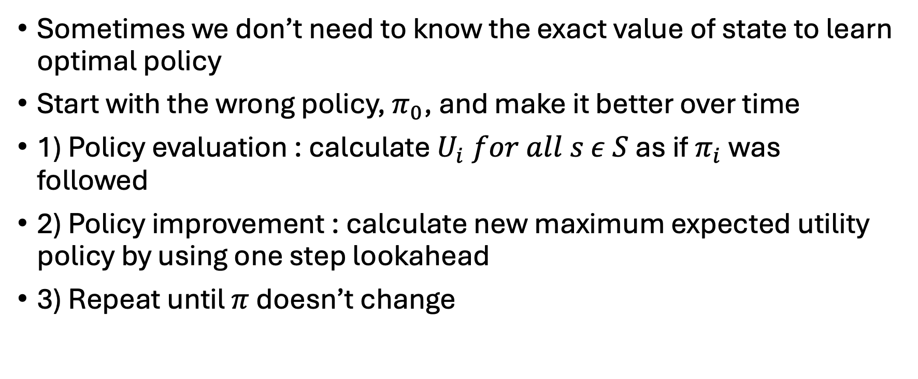
Policy Iteration
Sometimes we don’t need to know the exact value of state to learn optimal policy
Start with the wrong policy, $π_{0}$, and make it better over time
1) Policy evaluation : calculate $U_{i} for all s ε S$ as if $π_{i}$ was followed
2) Policy improvement : calculate new maximum expected utility policy by using one step lookahead
3) Repeat until $π$ doesn’t change
Notes:
Good metaphor for segway into policy iteration. How does having a action that is clearly better than others affect how long value iteration runs for? It doesn’t!! Value iteration is still going to run until it finds the actual value of the action / state pair, even if its terrible

Slide 10
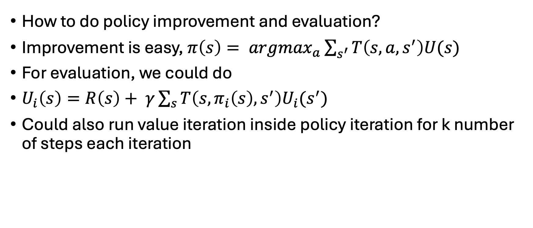
Policy Iteration
How to do policy improvement and evaluation?
Improvement is easy, $π\left(s\right)= {argmax}_{a}\sum_{s^{′}}{T\left(s, a, s^{′}\right)U(s)}$
For evaluation, we could do
$U_{i}\left(s\right)=R\left(s\right)+ γ\sum_{s}{T\left(s, π_{i}\left(s\right), s^{′}\right)U_{i}(s^{′})}$
Could also run value iteration inside policy iteration for k number of steps each iteration

Slide 11
Reinforcement Learning (RL)
What if we don’t know the transition function?
Reinforcement learning should be used when you don’t know all the information
The agent samples the environment, exploring it by taking actions and receiving observations
Model based RL uses these samples to try and build our transition function
Model free RL tries to directly learn the policy, doesn’t model the world

Slide 12
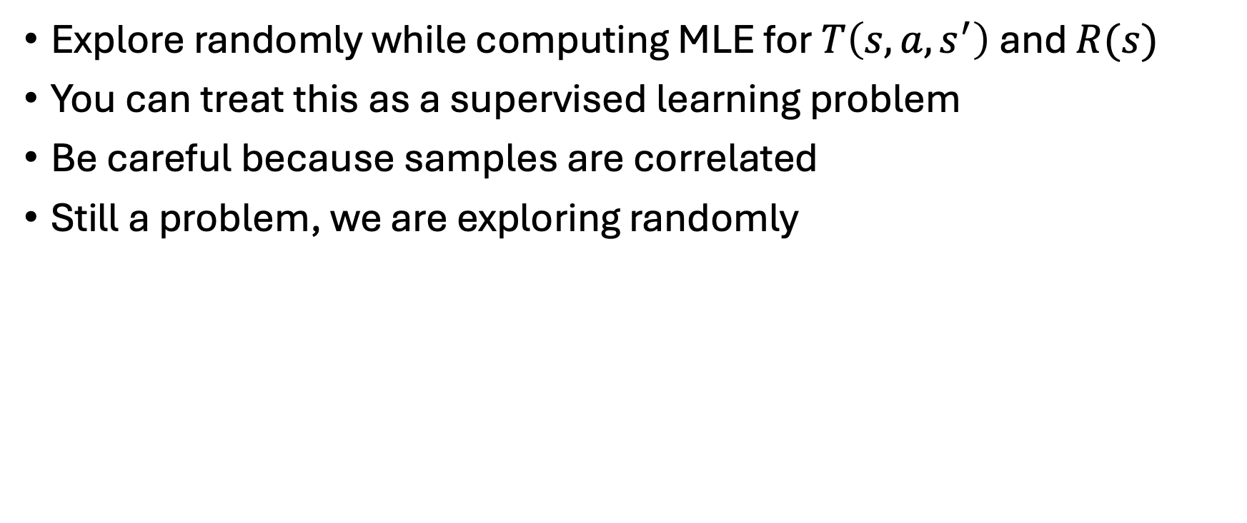
Model Based
Explore randomly while computing MLE for $T\left(s, a, s^{′}\right)$ and $R(s)$
You can treat this as a supervised learning problem
Be careful because samples are correlated
Still a problem, we are exploring randomly

Slide 13
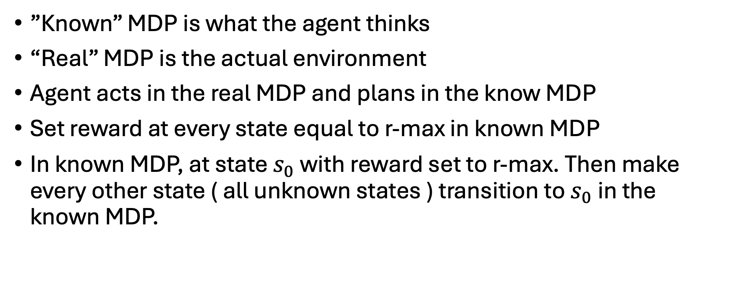
R-Max
”Known” MDP is what the agent thinks
“Real” MDP is the actual environment
Agent acts in the real MDP and plans in the know MDP
Set reward at every state equal to r-max in known MDP
In known MDP, at state $s_{0}$ with reward set to r-max. Then make every other state ( all unknown states ) transition to $s_{0}$ in the known MDP.

Slide 14
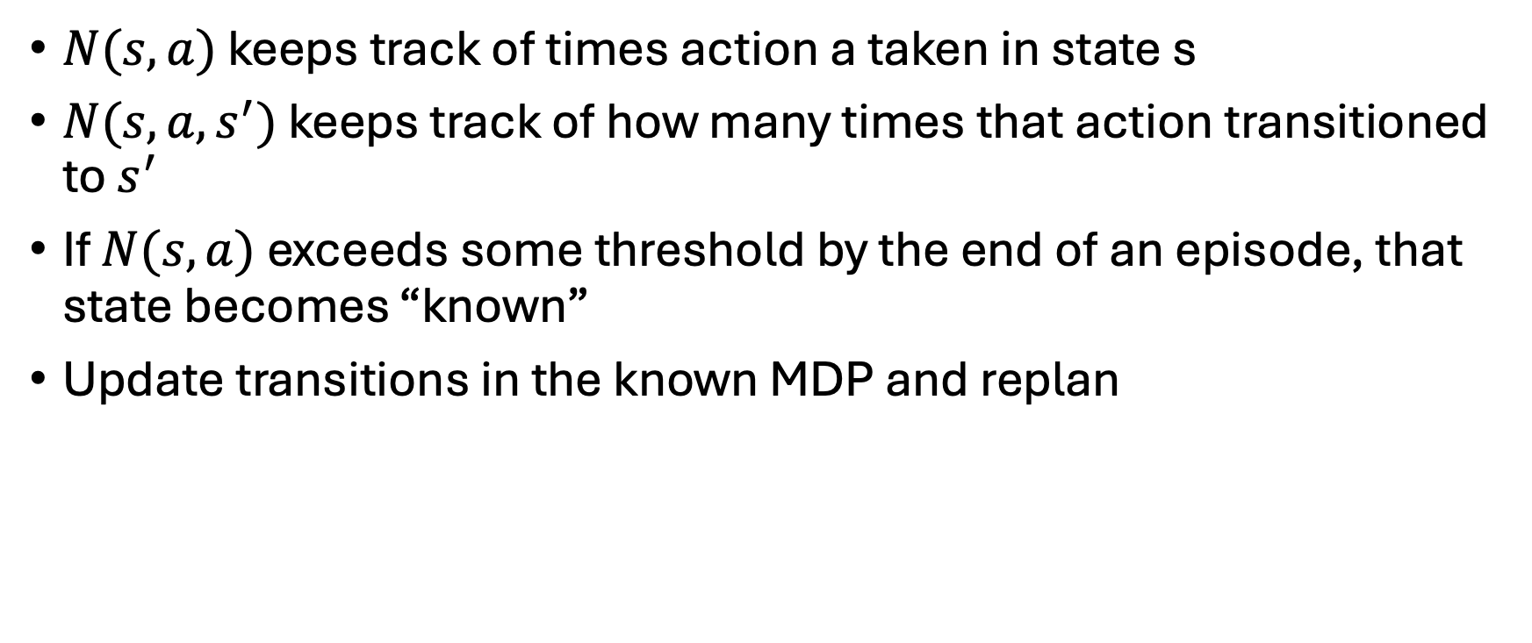
R-Max
$N(s, a)$ keeps track of times action a taken in state s
$N(s, a, s^{′})$ keeps track of how many times that action transitioned to $s^{′}$
If $N(s, a)$ exceeds some threshold by the end of an episode, that state becomes “known”
Update transitions in the known MDP and replan

Slide 15
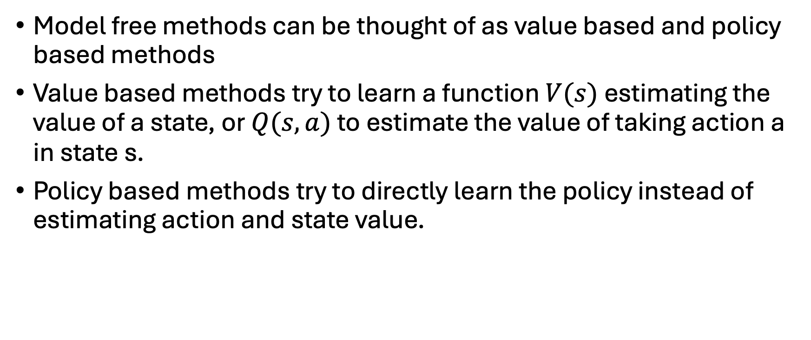
Model Free Methods
Model free methods can be thought of as value based and policy based methods
Value based methods try to learn a function $V(s)$ estimating the value of a state, or $Q(s,a)$ to estimate the value of taking action a in state s.
Policy based methods try to directly learn the policy instead of estimating action and state value.

Slide 16
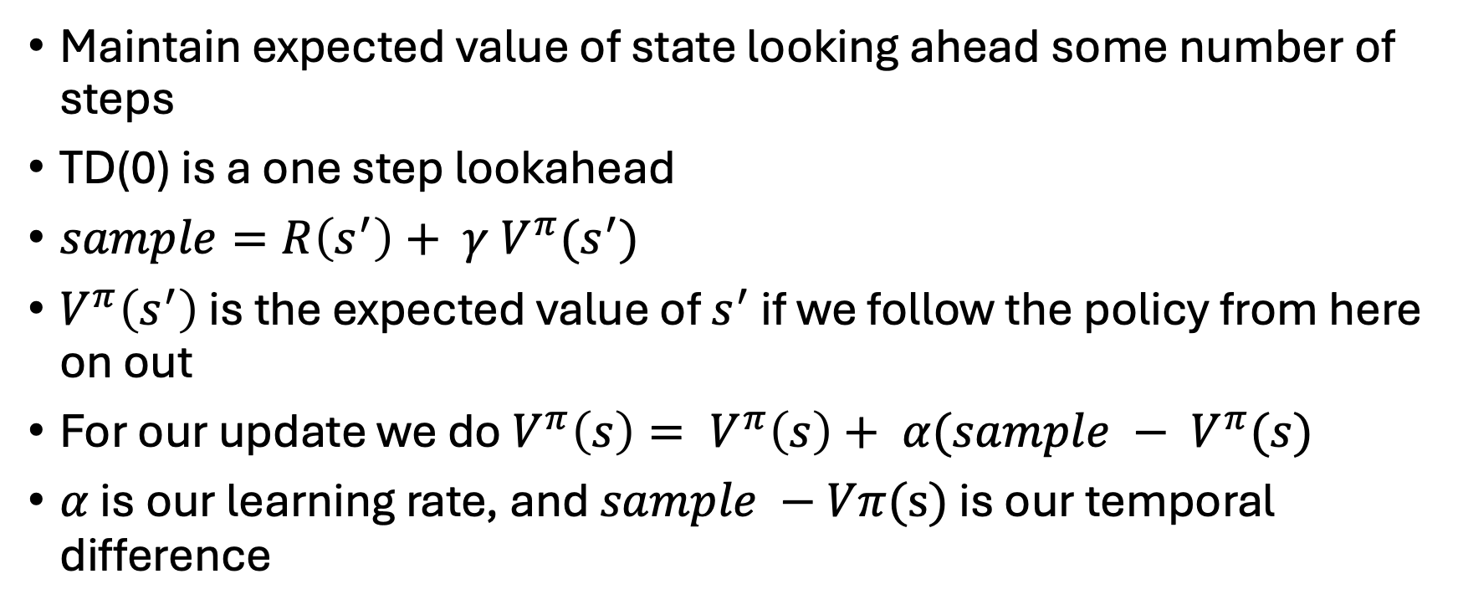
Temporal difference learning
Maintain expected value of state looking ahead some number of steps
TD(0) is a one step lookahead
$sample=R\left(s^{′}\right)+ γ V^{π}(s^{′})$
$V^{π}\left(s^{′}\right)$ is the expected value of $s^{′}$ if we follow the policy from here on out
For our update we do $V^{π}\left(s\right)= V^{π}\left(s\right)+ α(sample − V^{π}(s)$
$α$ is our learning rate, and $sample −Vπ(s)$ is our temporal difference

Slide 17
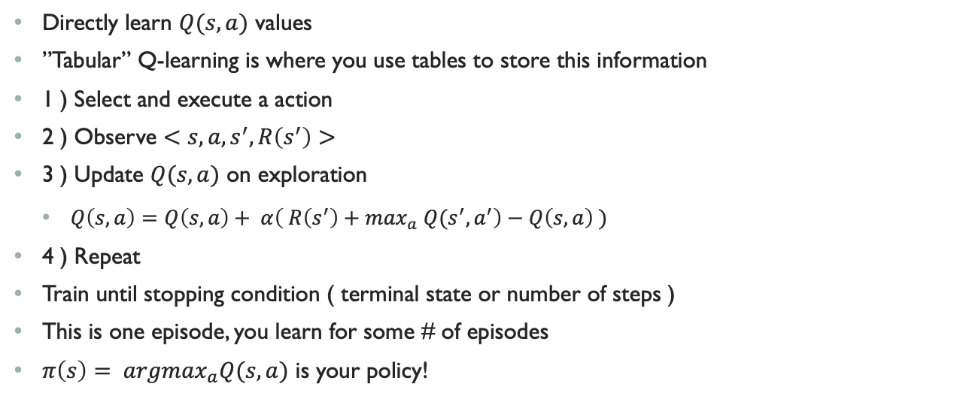
Q-Learning
Directly learn $Q(s,a)$ values
”Tabular” Q-learning is where you use tables to store this information
1 ) Select and execute a action
2 ) Observe $<s, a, s^{′}, R\left(s^{′}\right)>$
3 ) Update $Q(s, a)$ on exploration
  $Q\left(s,a\right)=Q\left(s,a\right)+ α\left( R\left(s^{′}\right)+\max_{a} Q{(s}^{′}, a^{′}\right)−Q\left(s,a\right) )$
4 ) Repeat
Train until stopping condition ( terminal state or number of steps )
This is one episode, you learn for some # of episodes
$π\left(s\right)= {argmax}_{a}Q(s,a)$ is your policy!

Slide 18
Q-Learning
How do we select our actions though?
Many selection policies such as e-greedy, Boltzmann, Thompson sampling, etc.
Most important thing is that we want our action selection policy to be Greedy in the Limit of Infinite Exploration
Basically, if we ran it forever it would eventually converge to the optimal policy

Slide 19
Q-Learnings Problem
Q-learning if off-policy
Updates value estimate according to policy that is different from select policy
Agent can be reckless, because it doesn’t consider action selection randomness
This can hurt episode efficiency
If we can reason about what we might do more accurately, we can explore more of the state space early on

Slide 20
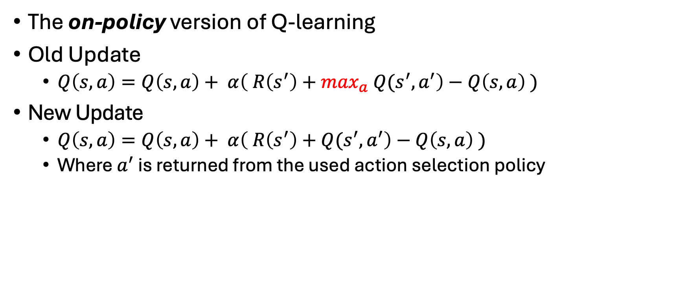
SARSA
The on-policy version of Q-learning
Old Update
  $Q\left(s,a\right)=Q\left(s,a\right)+ α\left( R\left(s^{′}\right)+\max_{a} Q{(s}^{′}, a^{′}\right)−Q\left(s,a\right) )$
New Update
  $Q\left(s,a\right)=Q\left(s,a\right)+ α\left( R\left(s^{′}\right)+Q{(s}^{′}, a^{′}\right)−Q\left(s,a\right) )$
  Where $a^{′}$ is returned from the used action selection policy

Slide 21
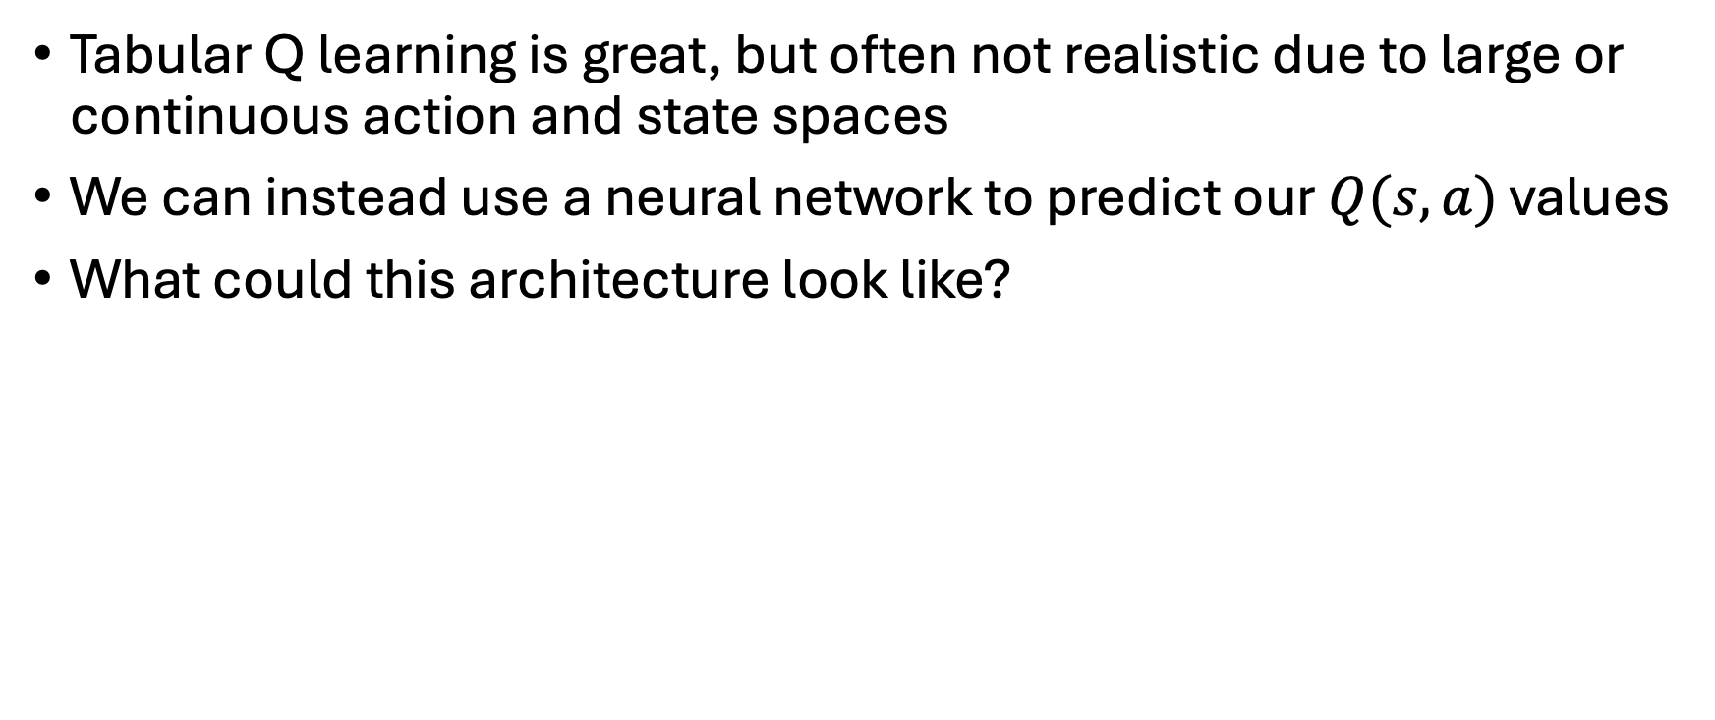
Deep Q
Tabular Q learning is great, but often not realistic due to large or continuous action and state spaces
We can instead use a neural network to predict our $Q(s,a)$ values
What could this architecture look like?

Slide 22
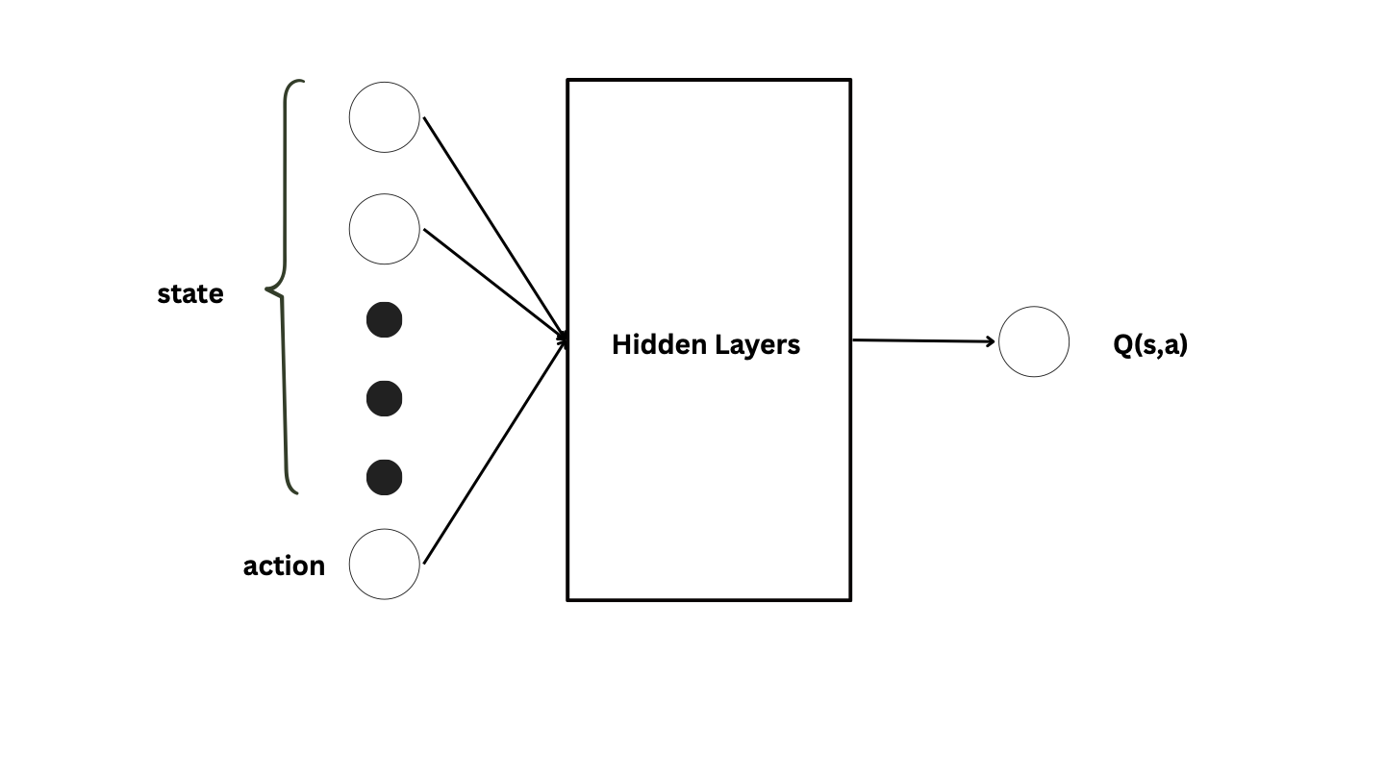
Deep-Q Architecture 1

Slide 23
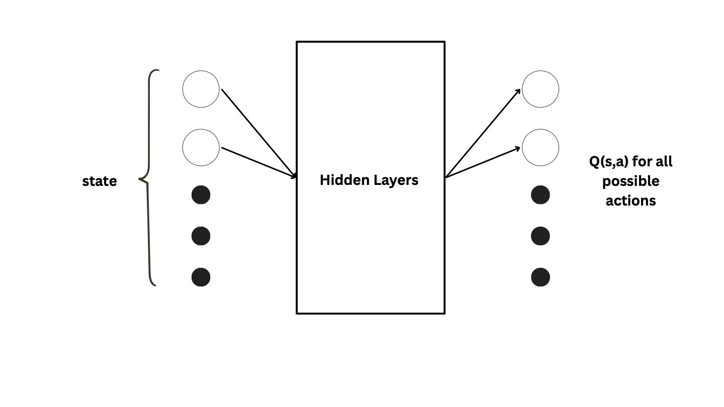
Deep-Q Architecture 2

Slide 24
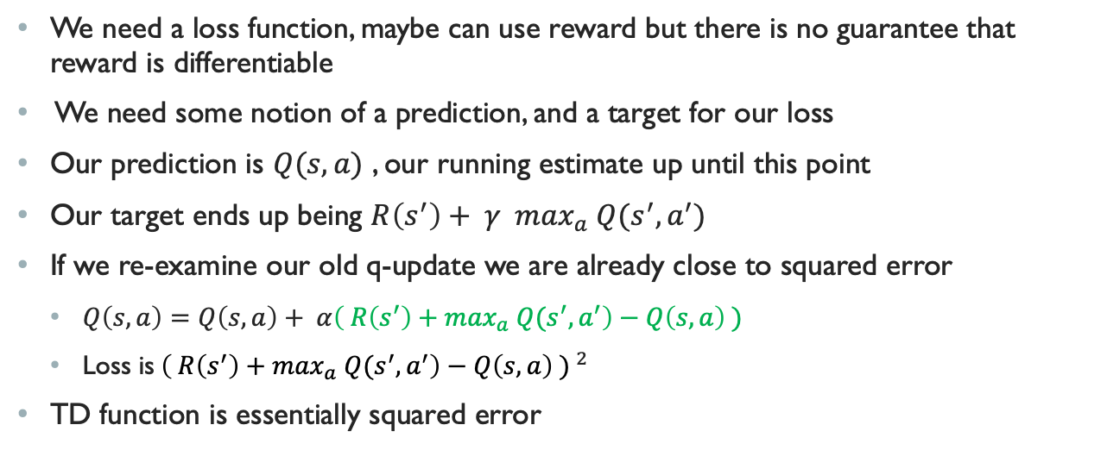
Deep-Q
We need a loss function, maybe can use reward but there is no guarantee that reward is differentiable
We need some notion of a prediction, and a target for our loss
Our prediction is $Q(s,a)$ , our running estimate up until this point
Our target ends up being $R\left(s^{′}\right)+ γ \max_{a} Q(s^{′}, a^{′})$
If we re-examine our old q-update we are already close to squared error
  $Q\left(s,a\right)=Q\left(s,a\right)+ α\left( R\left(s^{′}\right)+\max_{a} Q{(s}^{′}, a^{′}\right)−Q\left(s,a\right) )$
  Loss is${\left( R\left(s^{′}\right)+\max_{a} Q{(s}^{′}, a^{′}\right)−Q\left(s,a\right) ) }^{2}$
TD function is essentially squared error
Notes:
Go back to arch 2 and explain how we can make sure to avoid the loss from nodes that aren’t the action we take. Basically set the loss to those nodes to be equal to exactly their prediction to avoid their loss backpropagating through the network when we didn’t learn anything from them that step

Slide 25
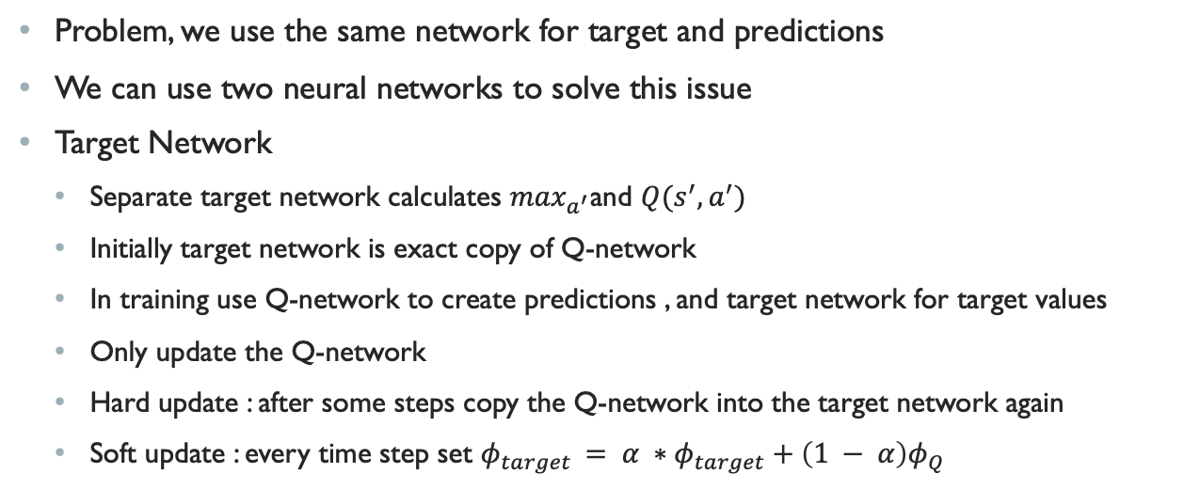
Deep-Q
Problem, we use the same network for target and predictions
We can use two neural networks to solve this issue
Target Network
  Separate target network calculates $\max_{a^{′}}$and $Q(s^{′}, a^{′})$
  Initially target network is exact copy of Q-network
  In training use Q-network to create predictions , and target network for target values
  Only update the Q-network
  Hard update : after some steps copy the Q-network into the target network again
  Soft update : every time step set $φ_{target }= {α ∗φ}_{target}+\left(1 − α\right)φ_{Q}$

Slide 26
Deep-Q
If we just pass in models, there is a correlation issue that leaves us prone to overfitting to our trajectories
Use experience replay buffer to get around this
1 ) Take action
2 ) Observe result
3 ) Add observation to replay
4 ) Sample batch from buffer and update according to batch

Slide 27
Policy Search
Upsides
  Can use state features, not just state given in MDP to consider more information
  Convergence is better
  Does better in high dimensional spaces
  Can learn stochastic policies
Downsides
  Prone to converging to local optima
  Evaluating a policy could have high variance

Slide 28
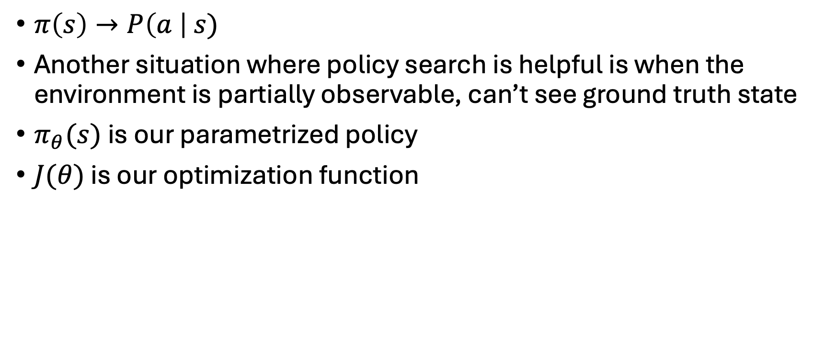
Policy Search
$π\left(s\right)→P\left(a \right| s)$
Another situation where policy search is helpful is when the environment is partially observable, can’t see ground truth state
$π_{θ}(s)$ is our parametrized policy
$J(θ)$ is our optimization function

Slide 29
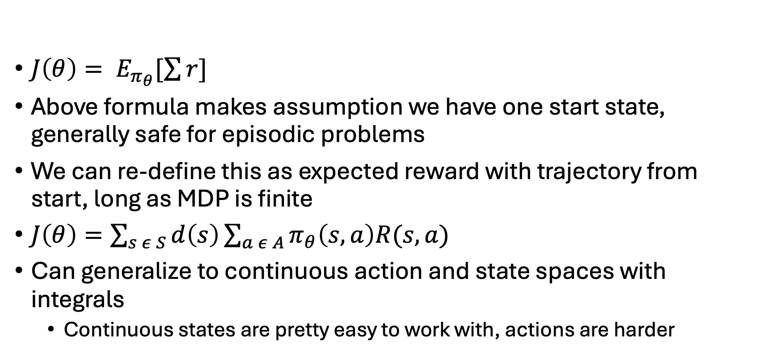
Policy Search
$J\left(θ\right)= E_{π_{θ}}[\sum{r}]$
Above formula makes assumption we have one start state, generally safe for episodic problems
We can re-define this as expected reward with trajectory from start, long as MDP is finite
$J\left(θ\right)=\sum_{s ε S}{d\left(s\right)\sum_{a ε A}{π_{θ}\left(s,a\right)R(s,a)}}$
Can generalize to continuous action and state spaces with integrals
  Continuous states are pretty easy to work with, actions are harder

Slide 30
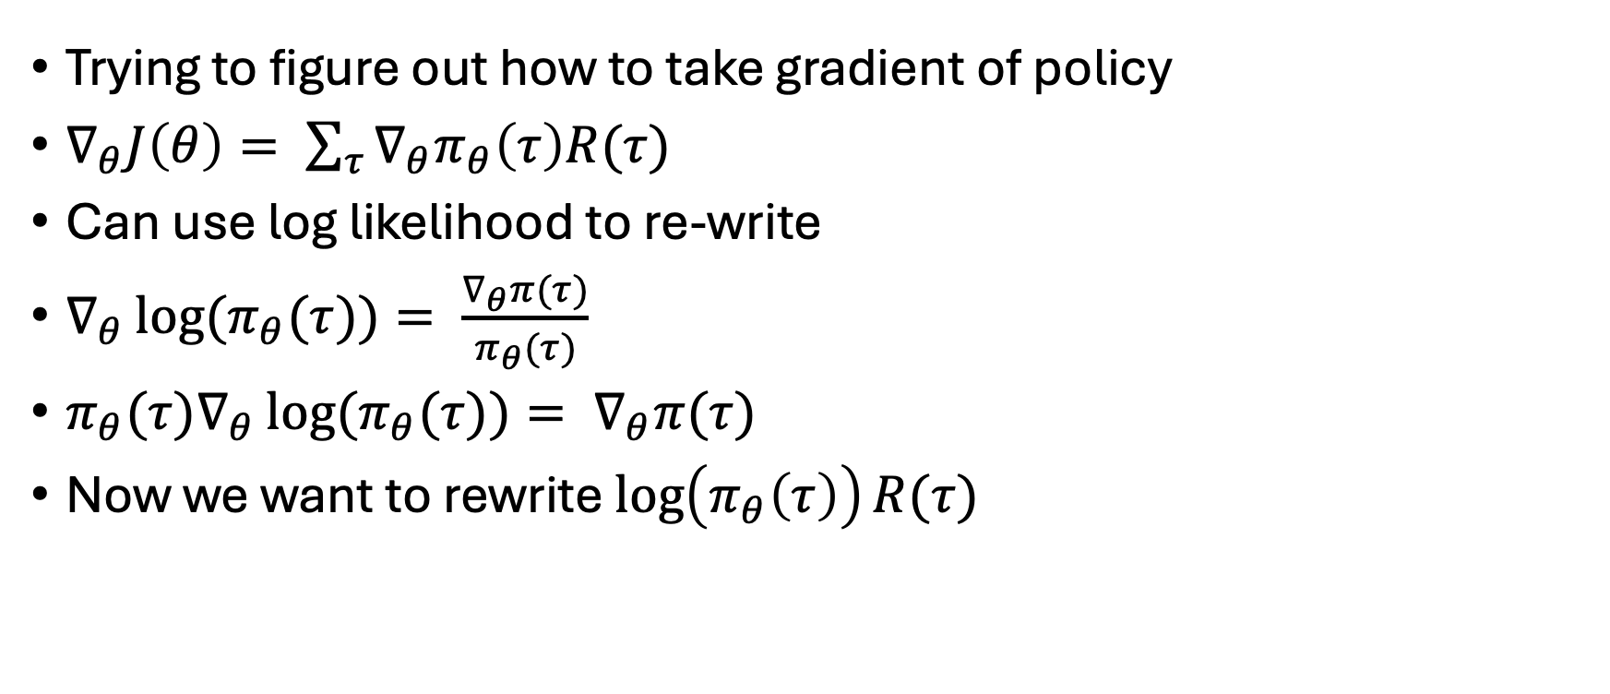
Policy Gradients
Trying to figure out how to take gradient of policy
$∇_{θ}J\left(θ\right)= \sum_{τ}{∇_{θ}π_{θ}\left(τ\right)R(τ)}$
Can use log likelihood to re-write
$∇_{θ}\log{(π_{θ}(τ))}= \frac{∇_{θ}π(τ)}{π_{θ}(τ)}$
${π_{θ}(τ)∇}_{θ}\log{(π_{θ}(τ))}= ∇_{θ}π(τ)$
Now we want to rewrite $\log\left(π_{θ}\left(τ\right)\right)R(τ)$
Notes:
Trying to set this up so we don’t have to take derivative of reward itself, since we can’t guarantee it will differentiable for our loss .

Slide 31
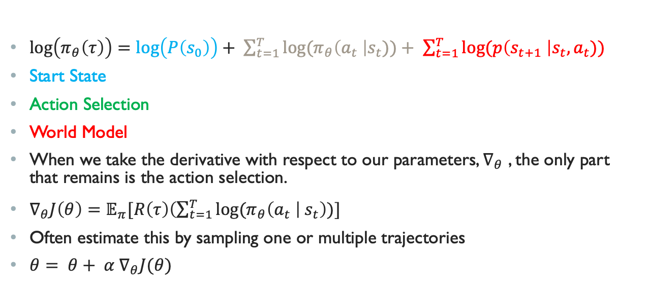
Policy Gradients
$\log\left(π_{θ}\left(τ\right)\right)=\log\left(P\left(s_{0}\right)\right)+ \sum_{t=1}^{T}{log⁡(π_{θ}\left(a_{t} \right|s_{t}))+ \sum_{t=1}^{T}{log⁡(p\left(s_{t+1} \right|s_{t}, a_{t}))}}$
Start State
Action Selection
World Model
When we take the derivative with respect to our parameters, $∇_{θ}$ , the only part that remains is the action selection.
$∇_{θ}J\left(θ\right)=𝔼_{π}[R\left(τ\right)\left(\sum_{t=1}^{T}{log⁡(π_{θ}\left(a_{t} \right| s_{t}}\right))]$
Often estimate this by sampling one or multiple trajectories
$θ= θ+ α ∇_{θ}J(θ)$

Slide 32
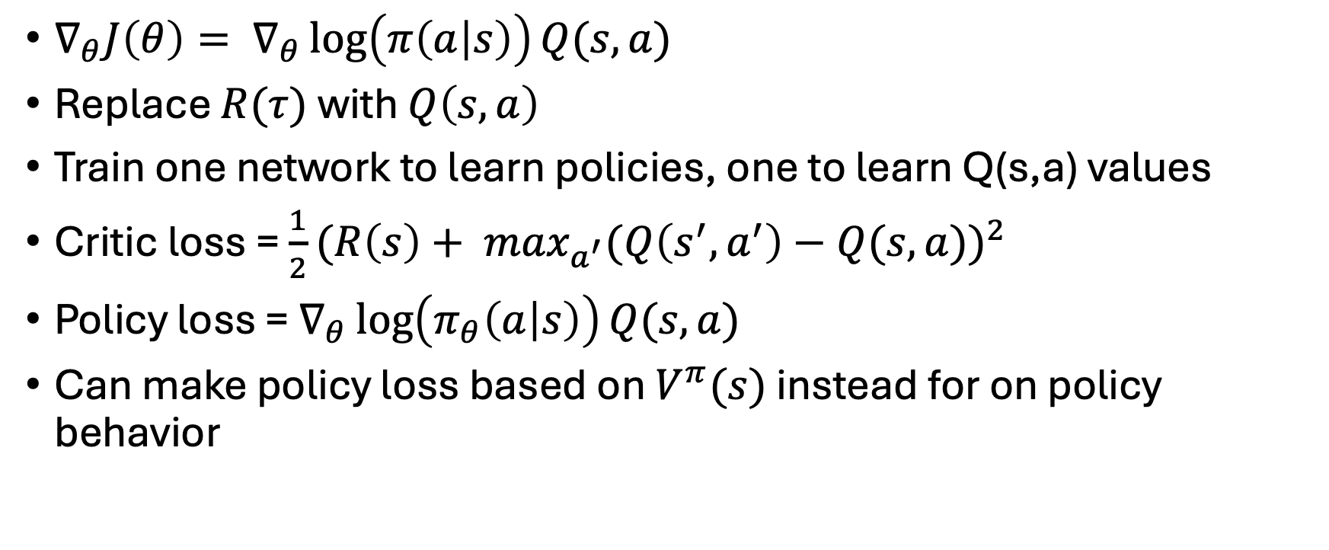
Actor Critic
$∇_{θ}J\left(θ\right)= ∇_{θ}\log\left(π\left(a | s\right)\right)Q(s,a)$
Replace $R(τ)$ with $Q\left(s,a\right)$
Train one network to learn policies, one to learn Q(s,a) values
Critic loss = $\frac{1}{2}(R\left(s\right)+ \max_{a^{′}}(Q\left(s^{′},a^{′}\right)−Q(s,a))^{2}$
Policy loss = $∇_{θ}\log\left(π_{θ}\left(a | s\right)\right)Q(s,a)$
Can make policy loss based on $V^{π}(s)$ instead for on policy behavior

Slide 33
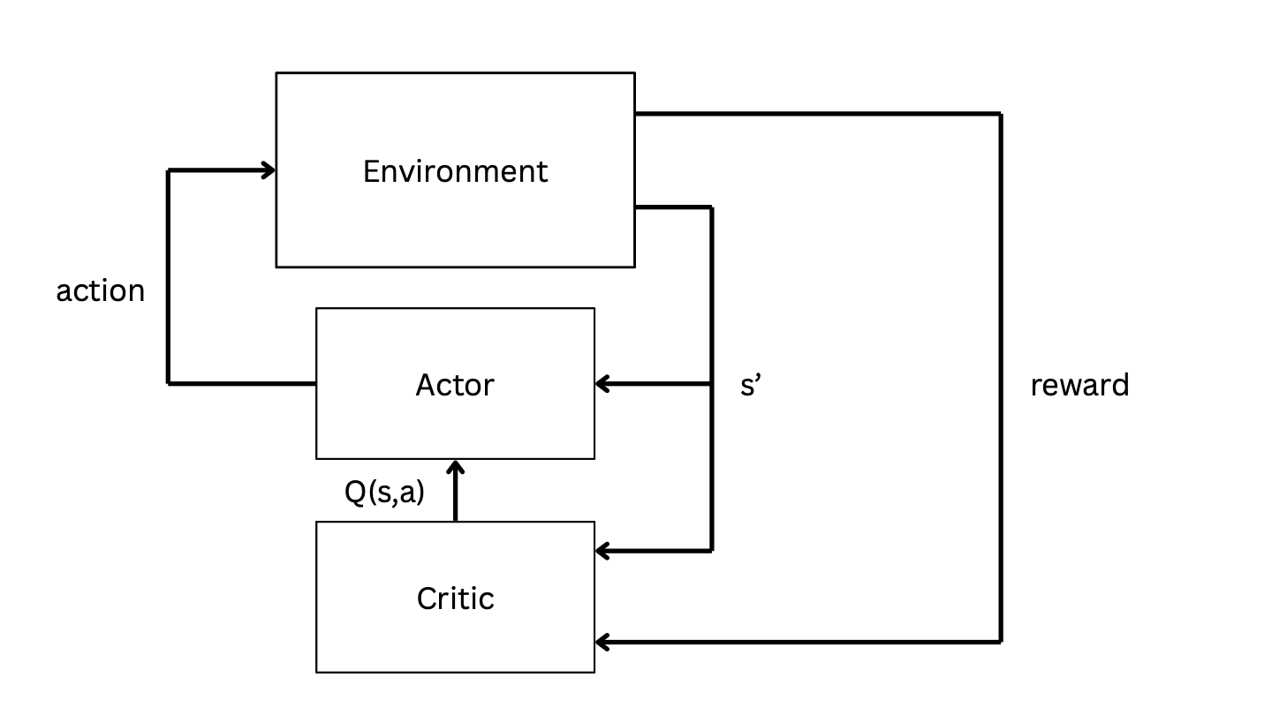

Slide 34
A3C ( Asynchronous Advantage Actor Critic )
Spawn multiple worker threads each containing parameters for agents
Workers run episodes independently, if it finishes it passes gradients to manager agent
Manger updates critic and actor networks, passes new parameters and sends agent off once again

Slide 35
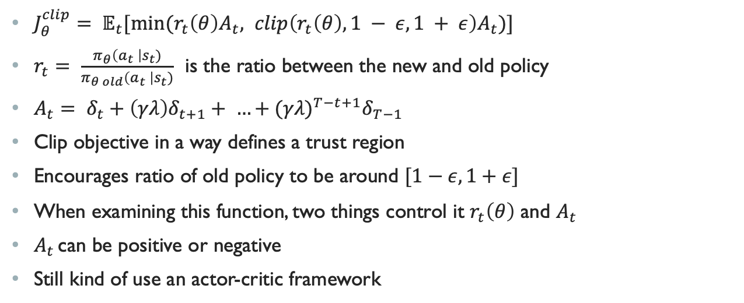
PPO ( Proximal Policy Optimization )
$J_{θ}^{clip}= 𝔼_{t}[min⁡(r_{t}\left(θ\right)A_{t}, clip\left(r_{t}\left(θ\right), 1 − ε, 1 + ε\right)A_{t})]$
$r_{t}= \frac{π_{θ}\left(a_{t} \right|s_{t})}{π_{θ old}\left(a_{t} \right|s_{t})}$ is the ratio between the new and old policy
$A_{t}= δ_{t}+\left(γλ\right)δ_{t+1}+ …+(γλ)^{T−t+1}δ_{T−1}$
Clip objective in a way defines a trust region
Encourages ratio of old policy to be around $[1−ε, 1+ε]$
When examining this function, two things control it $r_{t}\left(θ\right)$ and $A_{t}$
$A_{t }$can be positive or negative
Still kind of use an actor-critic framework
Notes:
A_t is an advantage estimator

Slide 36
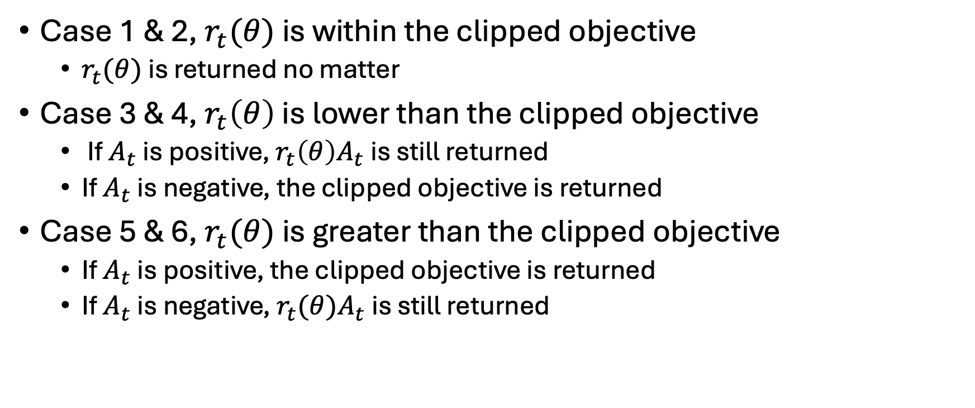
PPO ( Proximal Policy Optimization )
Case 1 & 2, $r_{t}(θ)$ is within the clipped objective
  $r_{t}(θ)$ is returned no matter
Case 3 & 4, $r_{t}\left(θ\right)$ is lower than the clipped objective
  If $A_{t}$ is positive, $r_{t}\left(θ\right)A_{t}$ is still returned
  If $A_{t}$ is negative, the clipped objective is returned
Case 5 & 6, $r_{t}(θ)$ is greater than the clipped objective
  If $A_{t}$ is positive, the clipped objective is returned
  If $A_{t}$ is negative, $r_{t}(θ)A_{t}$ is still returned

Slide 37
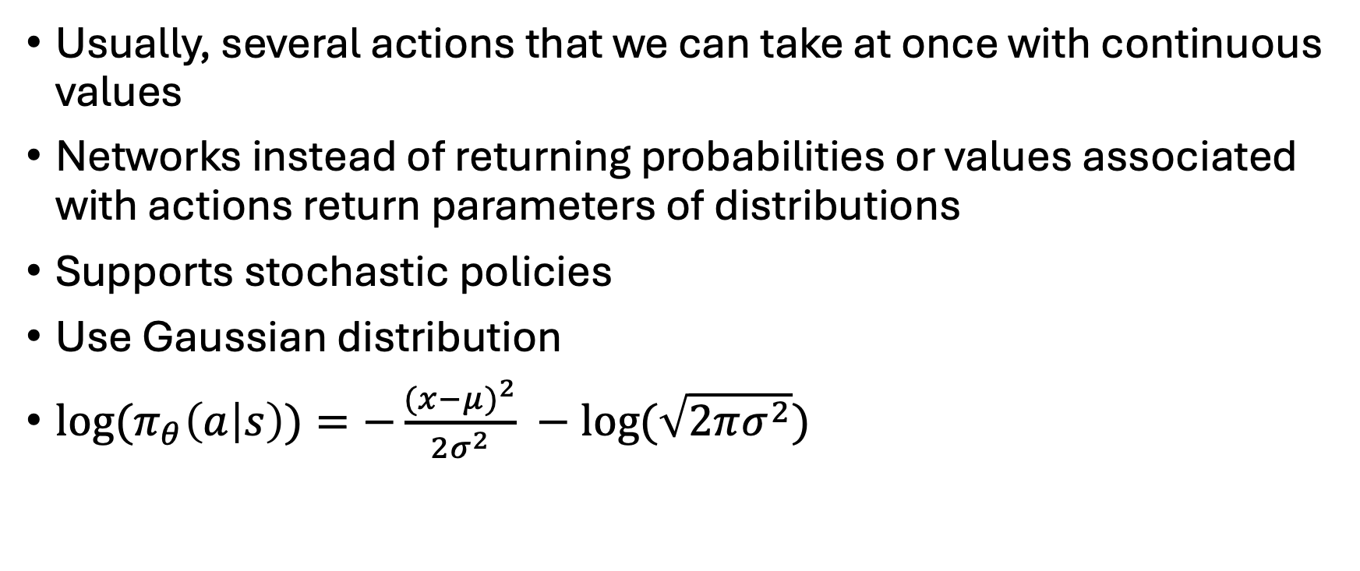
Continuous Action Spaces
Usually, several actions that we can take at once with continuous values
Networks instead of returning probabilities or values associated with actions return parameters of distributions
Supports stochastic policies
Use Gaussian distribution
$log⁡(π_{θ}\left(a | s\right))=−\frac{(x−μ)^{2}}{2σ^{2}} −log⁡(\sqrt{2πσ^{2}})$

Slide 38
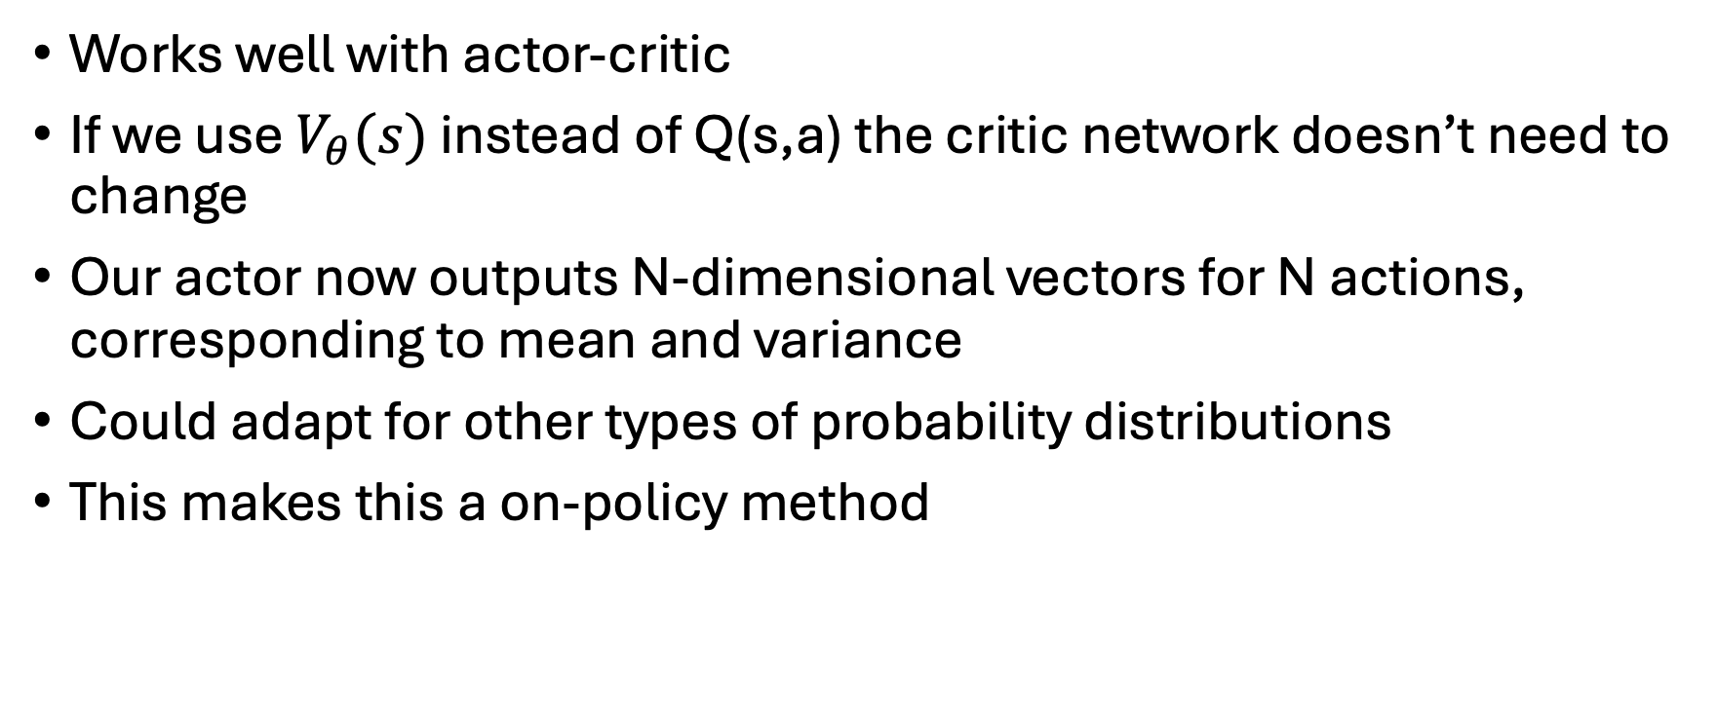
Continuous Action Space
Works well with actor-critic
If we use $V_{θ}(s)$ instead of Q(s,a) the critic network doesn’t need to change
Our actor now outputs N-dimensional vectors for N actions, corresponding to mean and variance
Could adapt for other types of probability distributions
This makes this a on-policy method

